Slide 1
Lecture 13 Abstract Data Type Unsorted List and Sorted List (Linked-list-based Implementation]

Slide 2
class SortedType<char>
SortedType
Private data:
length 3
listData
currentPos ?
MakeEmpty
~SortedType
C L X
RetrieveItem
InsertItem
DeleteItem
.
.
.
GetNextItem

Slide 3
sortedlinkedlist.h
#ifndef SORTEDLINKEDLIST_H_INCLUDED
#define SORTEDLINKEDLIST_H_INCLUDED
template <class ItemType>
class SortedType
{
struct NodeType
{
ItemType info;
NodeType* next;
};
public:
SortedType();
~SortedType();
bool IsFull();
int LengthIs();
void MakeEmpty();
void RetrieveItem(ItemType& item, bool& found);
void InsertItem(ItemType item);
void DeleteItem(ItemType item);
void ResetList();
void GetNextItem(ItemType& item);
private:
NodeType* listData;
int length;
NodeType* currentPos;
};
#endif // SORTEDLINKEDLIST_H_INCLUDED

Slide 4
sortedlinkedlist.cpp
#include "sortedlinkedlist.h"
#include<cstddef>
#include<new>
template <class ItemType>
SortedType<ItemType>::SortedType()
{
length = 0;
listData = NULL;
currentPos = NULL;
}
template <class ItemType>
int SortedType<ItemType>::LengthIs()
{
return length;
}
template<class ItemType>
bool SortedType<ItemType>::IsFull()
{
NodeType* location;
try
{
location = new NodeType;
delete location;
return false;
}
catch(std::bad_alloc& exception)
{
return true;
}
}

Slide 5
sortedlinkedlist.cpp
#include "sortedlinkedlist.h"
#include<cstddef>
#include<new>
template <class ItemType>
SortedType<ItemType>::SortedType()
{
length = 0;
listData = NULL;
currentPos = NULL;
}
template <class ItemType>
int SortedType<ItemType>::LengthIs()
{
return length;
}
template<class ItemType>
bool SortedType<ItemType>::IsFull()
{
NodeType* location;
try
{
location = new NodeType;
delete location;
return false;
}
catch(std::bad_alloc& exception)
{
return true;
}
}
O(1)
O(1)
O(1)

Slide 6
sortedlinkedlist.cpp
template <class ItemType>
void SortedType<ItemType>::MakeEmpty()
{
NodeType* tempPtr;
while (listData != NULL)
{
tempPtr = listData;
listData = listData->next;
delete tempPtr;
}
length = 0;
}
template <class ItemType>
SortedType<ItemType>::~SortedType()
{
MakeEmpty();
}

Slide 7
sortedlinkedlist.cpp
template <class ItemType>
void SortedType<ItemType>::MakeEmpty()
{
NodeType* tempPtr;
while (listData != NULL)
{
tempPtr = listData;
listData = listData->next;
delete tempPtr;
}
length = 0;
}
template <class ItemType>
SortedType<ItemType>::~SortedType()
{
MakeEmpty();
}
O(N)
O(N)

Slide 8
sortedlinkedlist.cpp
template <class ItemType>
void SortedType<ItemType>::ResetList()
{
currentPos = NULL;
}
template <class ItemType>
void SortedType<ItemType>::GetNextItem(ItemType& item)
{
if (currentPos == NULL)
currentPos = listData;
else
currentPos = currentPos->next;
item = currentPos->info;
}

Slide 9
sortedlinkedlist.cpp
template <class ItemType>
void SortedType<ItemType>::ResetList()
{
currentPos = NULL;
}
template <class ItemType>
void SortedType<ItemType>::GetNextItem(ItemType& item)
{
if (currentPos == NULL)
currentPos = listData;
else
currentPos = currentPos->next;
item = currentPos->info;
}
O(1)
O(1)

Slide 10
sortedlinkedlist.cpp
template <class ItemType>
void SortedType<ItemType>::InsertItem(ItemType item)
{
NodeType* newNode;
NodeType* predLoc;
NodeType* location;
bool moreToSearch;
location = listData;
predLoc = NULL;
moreToSearch = (location != NULL);
while (moreToSearch)
{
if (location->info < item)
{
predLoc = location;
location = location->next;
moreToSearch = (location != NULL);
}
else moreToSearch = false;
}
newNode = new NodeType;
newNode->info = item;
if (predLoc == NULL)
{
newNode->next = listData;
listData = newNode;
}
else
{
newNode->next = location;
predLoc->next = newNode;
}
length++;
}

Slide 11
InsertItem(‘L’)
length
0
listData

Slide 12
InsertItem(‘L’)
template <class ItemType>
void SortedType<ItemType>::InsertItem(ItemType item)
{
NodeType* newNode;
NodeType* predLoc;
NodeType* location;
bool moreToSearch;
location = listData;
predLoc = NULL;
moreToSearch = (location != NULL);
length
0
listData

Slide 13
InsertItem(‘L’)
template <class ItemType>
void SortedType<ItemType>::InsertItem(ItemType item)
{
NodeType* newNode;
NodeType* predLoc;
NodeType* location;
bool moreToSearch;
location = listData;
predLoc = NULL;
moreToSearch = (location != NULL);
location
moreToSearch
predLoc
newNode
length
0
listData

Slide 14
InsertItem(‘L’)
template <class ItemType>
void SortedType<ItemType>::InsertItem(ItemType item)
{
NodeType* newNode;
NodeType* predLoc;
NodeType* location;
bool moreToSearch;
location = listData;
predLoc = NULL;
moreToSearch = (location != NULL);
location
moreToSearch
false
predLoc
newNode
length
0
listData

Slide 15
InsertItem(‘L’)
while (moreToSearch)
{
if (location->info < item)
{
predLoc = location;
location = location->next;
moreToSearch = (location != NULL);
}
else moreToSearch = false;
}
location
moreToSearch
false
predLoc
newNode
length
0
listData

Slide 16
InsertItem(‘L’)
while (moreToSearch)
{
if (location->info < item)
{
predLoc = location;
location = location->next;
moreToSearch = (location != NULL);
}
else moreToSearch = false;
}
location
moreToSearch
false
predLoc
newNode
length
0
listData

Slide 17
InsertItem(‘L’)
newNode = new NodeType;
newNode->info = item;
if (predLoc == NULL)
{
newNode->next = listData;
listData = newNode;
}
else
{
newNode->next = location;
predLoc->next = newNode;
}
length++;
}
location
moreToSearch
false
predLoc
newNode
length
0
listData

Slide 18
InsertItem(‘L’)
newNode = new NodeType;
newNode->info = item;
if (predLoc == NULL)
{
newNode->next = listData;
listData = newNode;
}
else
{
newNode->next = location;
predLoc->next = newNode;
}
length++;
}
location
moreToSearch
false
predLoc
newNode
length
0
listData

Slide 19
InsertItem(‘L’)
newNode = new NodeType;
newNode->info = item;
if (predLoc == NULL)
{
newNode->next = listData;
listData = newNode;
}
else
{
newNode->next = location;
predLoc->next = newNode;
}
length++;
}
location
moreToSearch
false
predLoc
newNode
length
0
listData
L

Slide 20
InsertItem(‘L’)
newNode = new NodeType;
newNode->info = item;
if (predLoc == NULL)
{
newNode->next = listData;
listData = newNode;
}
else
{
newNode->next = location;
predLoc->next = newNode;
}
length++;
}
location
moreToSearch
false
predLoc
newNode
length
0
listData
L

Slide 21
InsertItem(‘L’)
newNode = new NodeType;
newNode->info = item;
if (predLoc == NULL)
{
newNode->next = listData;
listData = newNode;
}
else
{
newNode->next = location;
predLoc->next = newNode;
}
length++;
}
location
moreToSearch
false
predLoc
newNode
length
0
listData
L

Slide 22
InsertItem(‘L’)
newNode = new NodeType;
newNode->info = item;
if (predLoc == NULL)
{
newNode->next = listData;
listData = newNode;
}
else
{
newNode->next = location;
predLoc->next = newNode;
}
length++;
}
location
moreToSearch
false
predLoc
newNode
length
0
listData
L

Slide 23
InsertItem(‘L’)
newNode = new NodeType;
newNode->info = item;
if (predLoc == NULL)
{
newNode->next = listData;
listData = newNode;
}
else
{
newNode->next = location;
predLoc->next = newNode;
}
length++;
}
location
moreToSearch
false
predLoc
newNode
length
1
listData
L

Slide 24
length
1
listData
L

Slide 25
InsertItem(‘A’)
length
1
listData
L

Slide 26
InsertItem(‘A’)
template <class ItemType>
void SortedType<ItemType>::InsertItem(ItemType item)
{
NodeType* newNode;
NodeType* predLoc;
NodeType* location;
bool moreToSearch;
location = listData;
predLoc = NULL;
moreToSearch = (location != NULL);
length
1
listData
L

Slide 27
InsertItem(‘A’)
template <class ItemType>
void SortedType<ItemType>::InsertItem(ItemType item)
{
NodeType* newNode;
NodeType* predLoc;
NodeType* location;
bool moreToSearch;
location = listData;
predLoc = NULL;
moreToSearch = (location != NULL);
location
moreToSearch
predLoc
newNode
length
1
listData
L

Slide 28
InsertItem(‘A’)
template <class ItemType>
void SortedType<ItemType>::InsertItem(ItemType item)
{
NodeType* newNode;
NodeType* predLoc;
NodeType* location;
bool moreToSearch;
location = listData;
predLoc = NULL;
moreToSearch = (location != NULL);
location
moreToSearch
true
predLoc
newNode
length
1
listData
L

Slide 29
InsertItem(‘A’)
while (moreToSearch)
{
if (location->info < item)
{
predLoc = location;
location = location->next;
moreToSearch = (location != NULL);
}
else moreToSearch = false;
}
location
moreToSearch
true
predLoc
newNode
length
1
listData
L

Slide 30
InsertItem(‘A’)
while (moreToSearch)
{
if (location->info < item)
{
predLoc = location;
location = location->next;
moreToSearch = (location != NULL);
}
else moreToSearch = false;
}
location
moreToSearch
true
predLoc
newNode
length
1
listData
L

Slide 31
InsertItem(‘A’)
while (moreToSearch)
{
if (location->info < item)
{
predLoc = location;
location = location->next;
moreToSearch = (location != NULL);
}
else moreToSearch = false;
}
location
moreToSearch
true
predLoc
newNode
length
1
listData
L

Slide 32
InsertItem(‘A’)
while (moreToSearch)
{
if (location->info < item)
{
predLoc = location;
location = location->next;
moreToSearch = (location != NULL);
}
else moreToSearch = false;
}
location
moreToSearch
false
predLoc
newNode
length
1
listData
L

Slide 33
InsertItem(‘A’)
while (moreToSearch)
{
if (location->info < item)
{
predLoc = location;
location = location->next;
moreToSearch = (location != NULL);
}
else moreToSearch = false;
}
location
moreToSearch
false
predLoc
newNode
length
1
listData
L

Slide 34
InsertItem(‘A’)
newNode = new NodeType;
newNode->info = item;
if (predLoc == NULL)
{
newNode->next = listData;
listData = newNode;
}
else
{
newNode->next = location;
predLoc->next = newNode;
}
length++;
}
location
moreToSearch
false
predLoc
newNode
length
1
listData
L

Slide 35
InsertItem(‘A’)
newNode = new NodeType;
newNode->info = item;
if (predLoc == NULL)
{
newNode->next = listData;
listData = newNode;
}
else
{
newNode->next = location;
predLoc->next = newNode;
}
length++;
}
location
moreToSearch
false
predLoc
newNode
length
1
listData
L

Slide 36
InsertItem(‘A’)
newNode = new NodeType;
newNode->info = item;
if (predLoc == NULL)
{
newNode->next = listData;
listData = newNode;
}
else
{
newNode->next = location;
predLoc->next = newNode;
}
length++;
}
location
moreToSearch
false
predLoc
newNode
length
1
listData
L
A

Slide 37
InsertItem(‘A’)
newNode = new NodeType;
newNode->info = item;
if (predLoc == NULL)
{
newNode->next = listData;
listData = newNode;
}
else
{
newNode->next = location;
predLoc->next = newNode;
}
length++;
}
location
moreToSearch
false
predLoc
newNode
length
1
listData
L
A

Slide 38
InsertItem(‘A’)
newNode = new NodeType;
newNode->info = item;
if (predLoc == NULL)
{
newNode->next = listData;
listData = newNode;
}
else
{
newNode->next = location;
predLoc->next = newNode;
}
length++;
}
location
moreToSearch
false
predLoc
newNode
length
1
listData
L
A

Slide 39
InsertItem(‘A’)
newNode = new NodeType;
newNode->info = item;
if (predLoc == NULL)
{
newNode->next = listData;
listData = newNode;
}
else
{
newNode->next = location;
predLoc->next = newNode;
}
length++;
}
location
moreToSearch
false
predLoc
newNode
length
1
L
listData
A

Slide 40
InsertItem(‘A’)
newNode = new NodeType;
newNode->info = item;
if (predLoc == NULL)
{
newNode->next = listData;
listData = newNode;
}
else
{
newNode->next = location;
predLoc->next = newNode;
}
length++;
}
location
moreToSearch
false
predLoc
newNode
length
2
L
listData
A

Slide 41
length
2
L
listData
A

Slide 42
InsertItem(‘S’)
length
2
L
listData
A

Slide 43
InsertItem(‘S’)
template <class ItemType>
void SortedType<ItemType>::InsertItem(ItemType item)
{
NodeType* newNode;
NodeType* predLoc;
NodeType* location;
bool moreToSearch;
location = listData;
predLoc = NULL;
moreToSearch = (location != NULL);
length
2
L
listData
A

Slide 44
InsertItem(‘S’)
template <class ItemType>
void SortedType<ItemType>::InsertItem(ItemType item)
{
NodeType* newNode;
NodeType* predLoc;
NodeType* location;
bool moreToSearch;
location = listData;
predLoc = NULL;
moreToSearch = (location != NULL);
newNode
moreToSearch
location
length
2
predLoc
L
listData
A

Slide 45
InsertItem(‘S’)
template <class ItemType>
void SortedType<ItemType>::InsertItem(ItemType item)
{
NodeType* newNode;
NodeType* predLoc;
NodeType* location;
bool moreToSearch;
location = listData;
predLoc = NULL;
moreToSearch = (location != NULL);
newNode
moreToSearch
true
location
length
2
predLoc
L
listData
A

Slide 46
InsertItem(‘S’)
while (moreToSearch)
{
if (location->info < item)
{
predLoc = location;
location = location->next;
moreToSearch = (location != NULL);
}
else moreToSearch = false;
}
newNode
moreToSearch
true
location
length
2
predLoc
L
listData
A

Slide 47
InsertItem(‘S’)
while (moreToSearch)
{
if (location->info < item)
{
predLoc = location;
location = location->next;
moreToSearch = (location != NULL);
}
else moreToSearch = false;
}
newNode
moreToSearch
true
location
length
2
predLoc
L
listData
A

Slide 48
InsertItem(‘S’)
while (moreToSearch)
{
if (location->info < item)
{
predLoc = location;
location = location->next;
moreToSearch = (location != NULL);
}
else moreToSearch = false;
}
newNode
moreToSearch
true
location
length
2
predLoc
L
listData
A

Slide 49
InsertItem(‘S’)
while (moreToSearch)
{
if (location->info < item)
{
predLoc = location;
location = location->next;
moreToSearch = (location != NULL);
}
else moreToSearch = false;
}
newNode
moreToSearch
true
location
length
2
predLoc
L
listData
A

Slide 50
InsertItem(‘S’)
while (moreToSearch)
{
if (location->info < item)
{
predLoc = location;
location = location->next;
moreToSearch = (location != NULL);
}
else moreToSearch = false;
}
newNode
moreToSearch
true
location
length
2
predLoc
L
listData
A

Slide 51
InsertItem(‘S’)
while (moreToSearch)
{
if (location->info < item)
{
predLoc = location;
location = location->next;
moreToSearch = (location != NULL);
}
else moreToSearch = false;
}
newNode
moreToSearch
true
location
length
2
predLoc
L
listData
A

Slide 52
InsertItem(‘S’)
while (moreToSearch)
{
if (location->info < item)
{
predLoc = location;
location = location->next;
moreToSearch = (location != NULL);
}
else moreToSearch = false;
}
newNode
moreToSearch
true
location
length
2
predLoc
L
listData
A

Slide 53
InsertItem(‘S’)
while (moreToSearch)
{
if (location->info < item)
{
predLoc = location;
location = location->next;
moreToSearch = (location != NULL);
}
else moreToSearch = false;
}
newNode
moreToSearch
true
location
length
2
predLoc
L
listData
A

Slide 54
InsertItem(‘S’)
while (moreToSearch)
{
if (location->info < item)
{
predLoc = location;
location = location->next;
moreToSearch = (location != NULL);
}
else moreToSearch = false;
}
newNode
moreToSearch
true
location
length
2
predLoc
L
listData
A

Slide 55
InsertItem(‘S’)
while (moreToSearch)
{
if (location->info < item)
{
predLoc = location;
location = location->next;
moreToSearch = (location != NULL);
}
else moreToSearch = false;
}
newNode
moreToSearch
true
location
length
2
predLoc
L
listData
A

Slide 56
InsertItem(‘S’)
while (moreToSearch)
{
if (location->info < item)
{
predLoc = location;
location = location->next;
moreToSearch = (location != NULL);
}
else moreToSearch = false;
}
newNode
moreToSearch
false
location
length
2
predLoc
L
listData
A

Slide 57
InsertItem(‘S’)
while (moreToSearch)
{
if (location->info < item)
{
predLoc = location;
location = location->next;
moreToSearch = (location != NULL);
}
else moreToSearch = false;
}
newNode
moreToSearch
false
location
length
2
predLoc
L
listData
A

Slide 58
InsertItem(‘S’)
newNode = new NodeType;
newNode->info = item;
if (predLoc == NULL)
{
newNode->next = listData;
listData = newNode;
}
else
{
newNode->next = location;
predLoc->next = newNode;
}
length++;
}
newNode
moreToSearch
false
location
length
2
predLoc
L
listData
A

Slide 59
InsertItem(‘S’)
newNode = new NodeType;
newNode->info = item;
if (predLoc == NULL)
{
newNode->next = listData;
listData = newNode;
}
else
{
newNode->next = location;
predLoc->next = newNode;
}
length++;
}
newNode
moreToSearch
false
location
S
length
2
predLoc
L
listData
A

Slide 60
InsertItem(‘S’)
newNode = new NodeType;
newNode->info = item;
if (predLoc == NULL)
{
newNode->next = listData;
listData = newNode;
}
else
{
newNode->next = location;
predLoc->next = newNode;
}
length++;
}
newNode
moreToSearch
false
location
S
length
2
predLoc
L
listData
A

Slide 61
InsertItem(‘S’)
newNode = new NodeType;
newNode->info = item;
if (predLoc == NULL)
{
newNode->next = listData;
listData = newNode;
}
else
{
newNode->next = location;
predLoc->next = newNode;
}
length++;
}
newNode
moreToSearch
false
location
S
length
2
predLoc
L
listData
A

Slide 62
InsertItem(‘S’)
newNode = new NodeType;
newNode->info = item;
if (predLoc == NULL)
{
newNode->next = listData;
listData = newNode;
}
else
{
newNode->next = location;
predLoc->next = newNode;
}
length++;
}
newNode
moreToSearch
false
location
S
length
2
predLoc
L
listData
A

Slide 63
InsertItem(‘S’)
newNode = new NodeType;
newNode->info = item;
if (predLoc == NULL)
{
newNode->next = listData;
listData = newNode;
}
else
{
newNode->next = location;
predLoc->next = newNode;
}
length++;
}
newNode
moreToSearch
false
location
S
length
2
predLoc
L
listData
A

Slide 64
InsertItem(‘S’)
newNode = new NodeType;
newNode->info = item;
if (predLoc == NULL)
{
newNode->next = listData;
listData = newNode;
}
else
{
newNode->next = location;
predLoc->next = newNode;
}
length++;
}
newNode
moreToSearch
false
location
S
length
3
predLoc
L
listData
A

Slide 65
S
length
3
L
listData
A

Slide 66
InsertItem(‘P’)
S
length
3
L
listData
A

Slide 67
InsertItem(‘P’)
template <class ItemType>
void SortedType<ItemType>::InsertItem(ItemType item)
{
NodeType* newNode;
NodeType* predLoc;
NodeType* location;
bool moreToSearch;
location = listData;
predLoc = NULL;
moreToSearch = (location != NULL);
S
length
3
L
listData
A

Slide 68
InsertItem(‘P’)
template <class ItemType>
void SortedType<ItemType>::InsertItem(ItemType item)
{
NodeType* newNode;
NodeType* predLoc;
NodeType* location;
bool moreToSearch;
location = listData;
predLoc = NULL;
moreToSearch = (location != NULL);
moreToSearch
location
S
length
3
predLoc
L
listData
A
newNode

Slide 69
InsertItem(‘P’)
template <class ItemType>
void SortedType<ItemType>::InsertItem(ItemType item)
{
NodeType* newNode;
NodeType* predLoc;
NodeType* location;
bool moreToSearch;
location = listData;
predLoc = NULL;
moreToSearch = (location != NULL);
moreToSearch
true
location
S
length
3
predLoc
L
listData
A
newNode

Slide 70
InsertItem(‘P’)
while (moreToSearch)
{
if (location->info < item)
{
predLoc = location;
location = location->next;
moreToSearch = (location != NULL);
}
else moreToSearch = false;
}
moreToSearch
true
location
S
length
3
predLoc
L
listData
A
newNode

Slide 71
InsertItem(‘P’)
while (moreToSearch)
{
if (location->info < item)
{
predLoc = location;
location = location->next;
moreToSearch = (location != NULL);
}
else moreToSearch = false;
}
moreToSearch
true
location
S
length
3
predLoc
L
listData
A
newNode

Slide 72
InsertItem(‘P’)
while (moreToSearch)
{
if (location->info < item)
{
predLoc = location;
location = location->next;
moreToSearch = (location != NULL);
}
else moreToSearch = false;
}
moreToSearch
true
location
S
length
3
predLoc
L
listData
A
newNode

Slide 73
InsertItem(‘P’)
while (moreToSearch)
{
if (location->info < item)
{
predLoc = location;
location = location->next;
moreToSearch = (location != NULL);
}
else moreToSearch = false;
}
moreToSearch
true
location
S
length
3
predLoc
L
listData
A
newNode

Slide 74
InsertItem(‘P’)
while (moreToSearch)
{
if (location->info < item)
{
predLoc = location;
location = location->next;
moreToSearch = (location != NULL);
}
else moreToSearch = false;
}
moreToSearch
true
location
S
length
3
predLoc
L
listData
A
newNode

Slide 75
InsertItem(‘P’)
while (moreToSearch)
{
if (location->info < item)
{
predLoc = location;
location = location->next;
moreToSearch = (location != NULL);
}
else moreToSearch = false;
}
moreToSearch
true
location
S
length
3
predLoc
L
listData
A
newNode

Slide 76
InsertItem(‘P’)
while (moreToSearch)
{
if (location->info < item)
{
predLoc = location;
location = location->next;
moreToSearch = (location != NULL);
}
else moreToSearch = false;
}
moreToSearch
true
location
S
length
3
predLoc
L
listData
A
newNode

Slide 77
InsertItem(‘P’)
while (moreToSearch)
{
if (location->info < item)
{
predLoc = location;
location = location->next;
moreToSearch = (location != NULL);
}
else moreToSearch = false;
}
moreToSearch
true
location
S
length
3
predLoc
L
listData
A
newNode

Slide 78
InsertItem(‘P’)
while (moreToSearch)
{
if (location->info < item)
{
predLoc = location;
location = location->next;
moreToSearch = (location != NULL);
}
else moreToSearch = false;
}
moreToSearch
true
location
S
length
3
predLoc
L
listData
A
newNode

Slide 79
InsertItem(‘P’)
while (moreToSearch)
{
if (location->info < item)
{
predLoc = location;
location = location->next;
moreToSearch = (location != NULL);
}
else moreToSearch = false;
}
moreToSearch
true
location
S
length
3
predLoc
L
listData
A
newNode

Slide 80
InsertItem(‘P’)
while (moreToSearch)
{
if (location->info < item)
{
predLoc = location;
location = location->next;
moreToSearch = (location != NULL);
}
else moreToSearch = false;
}
moreToSearch
true
location
S
length
3
predLoc
L
listData
A
newNode

Slide 81
InsertItem(‘P’)
while (moreToSearch)
{
if (location->info < item)
{
predLoc = location;
location = location->next;
moreToSearch = (location != NULL);
}
else moreToSearch = false;
}
moreToSearch
true
location
S
length
3
predLoc
L
listData
A
newNode

Slide 82
InsertItem(‘P’)
while (moreToSearch)
{
if (location->info < item)
{
predLoc = location;
location = location->next;
moreToSearch = (location != NULL);
}
else moreToSearch = false;
}
moreToSearch
true
location
S
length
3
predLoc
L
listData
A
newNode

Slide 83
InsertItem(‘P’)
while (moreToSearch)
{
if (location->info < item)
{
predLoc = location;
location = location->next;
moreToSearch = (location != NULL);
}
else moreToSearch = false;
}
moreToSearch
false
location
S
length
3
predLoc
L
listData
A
newNode

Slide 84
InsertItem(‘P’)
while (moreToSearch)
{
if (location->info < item)
{
predLoc = location;
location = location->next;
moreToSearch = (location != NULL);
}
else moreToSearch = false;
}
moreToSearch
false
location
S
length
3
predLoc
L
listData
A
newNode

Slide 85
InsertItem(‘P’)
newNode = new NodeType;
newNode->info = item;
if (predLoc == NULL)
{
newNode->next = listData;
listData = newNode;
}
else
{
newNode->next = location;
predLoc->next = newNode;
}
length++;
}
moreToSearch
false
location
S
length
3
predLoc
L
listData
A
newNode

Slide 86
InsertItem(‘P’)
newNode = new NodeType;
newNode->info = item;
if (predLoc == NULL)
{
newNode->next = listData;
listData = newNode;
}
else
{
newNode->next = location;
predLoc->next = newNode;
}
length++;
}
moreToSearch
false
location
S
length
3
predLoc
L
listData
A
newNode

Slide 87
InsertItem(‘P’)
newNode = new NodeType;
newNode->info = item;
if (predLoc == NULL)
{
newNode->next = listData;
listData = newNode;
}
else
{
newNode->next = location;
predLoc->next = newNode;
}
length++;
}
moreToSearch
false
location
S
length
3
predLoc
L
P
listData
A
newNode

Slide 88
InsertItem(‘P’)
newNode = new NodeType;
newNode->info = item;
if (predLoc == NULL)
{
newNode->next = listData;
listData = newNode;
}
else
{
newNode->next = location;
predLoc->next = newNode;
}
length++;
}
moreToSearch
false
location
S
length
3
predLoc
L
P
listData
A
newNode

Slide 89
InsertItem(‘P’)
newNode = new NodeType;
newNode->info = item;
if (predLoc == NULL)
{
newNode->next = listData;
listData = newNode;
}
else
{
newNode->next = location;
predLoc->next = newNode;
}
length++;
}
moreToSearch
false
location
S
length
3
predLoc
L
P
listData
A
newNode

Slide 90
InsertItem(‘P’)
newNode = new NodeType;
newNode->info = item;
if (predLoc == NULL)
{
newNode->next = listData;
listData = newNode;
}
else
{
newNode->next = location;
predLoc->next = newNode;
}
length++;
}
moreToSearch
false
location
S
length
3
predLoc
L
P
listData
A
newNode

Slide 91
InsertItem(‘P’)
newNode = new NodeType;
newNode->info = item;
if (predLoc == NULL)
{
newNode->next = listData;
listData = newNode;
}
else
{
newNode->next = location;
predLoc->next = newNode;
}
length++;
}
moreToSearch
false
location
S
length
3
predLoc
L
P
listData
A
newNode

Slide 92
InsertItem(‘P’)
newNode = new NodeType;
newNode->info = item;
if (predLoc == NULL)
{
newNode->next = listData;
listData = newNode;
}
else
{
newNode->next = location;
predLoc->next = newNode;
}
length++;
}
moreToSearch
false
location
S
length
4
predLoc
L
P
listData
A
newNode

Slide 93
S
P
length
4
L
listData
A

Slide 94
sortedlinkedlist.cpp
template <class ItemType>
void SortedType<ItemType>::InsertItem(ItemType item)
{
NodeType* newNode;
NodeType* predLoc;
NodeType* location;
bool moreToSearch;
location = listData;
predLoc = NULL;
moreToSearch = (location != NULL);
while (moreToSearch)
{
if (location->info < item)
{
predLoc = location;
location = location->next;
moreToSearch = (location != NULL);
}
else moreToSearch = false;
}
newNode = new NodeType;
newNode->info = item;
if (predLoc == NULL)
{
newNode->next = listData;
listData = newNode;
}
else
{
newNode->next = location;
predLoc->next = newNode;
}
length++;
}
O(N)

Slide 95
sortedlinkedlist.cpp
template <class ItemType>
void SortedType<ItemType>::DeleteItem(ItemType item)
{
NodeType* location = listData;
NodeType* tempLocation;
if (item == listData->info)
{
tempLocation = location;
listData = listData->next;
}
else
{
while (!(item==(location->next)->info))
location = location->next;
tempLocation = location->next;
location->next = (location->next)->next;
}
delete tempLocation;
length--;
}

Slide 96
sortedlinkedlist.cpp
template <class ItemType>
void SortedType<ItemType>::DeleteItem(ItemType item)
{
NodeType* location = listData;
NodeType* tempLocation;
if (item == listData->info)
{
tempLocation = location;
listData = listData->next;
}
else
{
while (!(item==(location->next)->info))
location = location->next;
tempLocation = location->next;
location->next = (location->next)->next;
}
delete tempLocation;
length--;
}
O(N)

Slide 97
sortedlinkedlist.cpp
template <class ItemType>
void SortedType<ItemType>::RetrieveItem(ItemType& item, bool& found)
{
NodeType* location = listData;
bool moreToSearch = (location != NULL);
found = false;
while (moreToSearch && !found)
{
if (item == location->info)
found = true;
else if (item < location->info)
{
location = location->next;
moreToSearch = (location != NULL);
}
else
moreToSearch = false;
}
}

Slide 98
sortedlinkedlist.cpp
template <class ItemType>
void SortedType<ItemType>::RetrieveItem(ItemType& item, bool& found)
{
NodeType* location = listData;
bool moreToSearch = (location != NULL);
found = false;
while (moreToSearch && !found)
{
if (item == location->info)
found = true;
else if (item < location->info)
{
location = location->next;
moreToSearch = (location != NULL);
}
else
moreToSearch = false;
}
}
O(N)

Slide 99
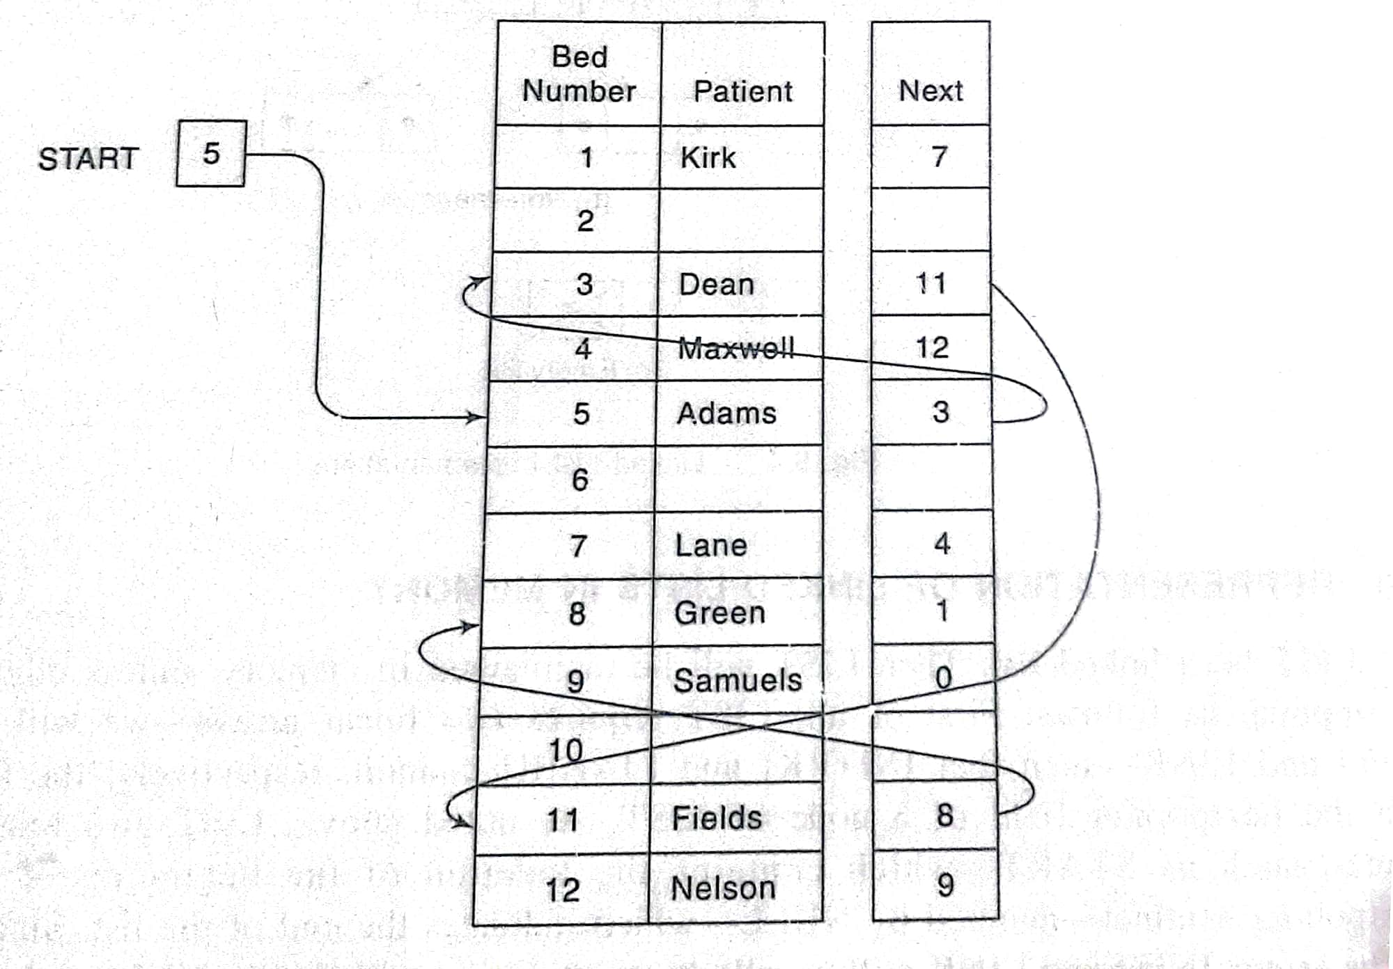

Slide 100
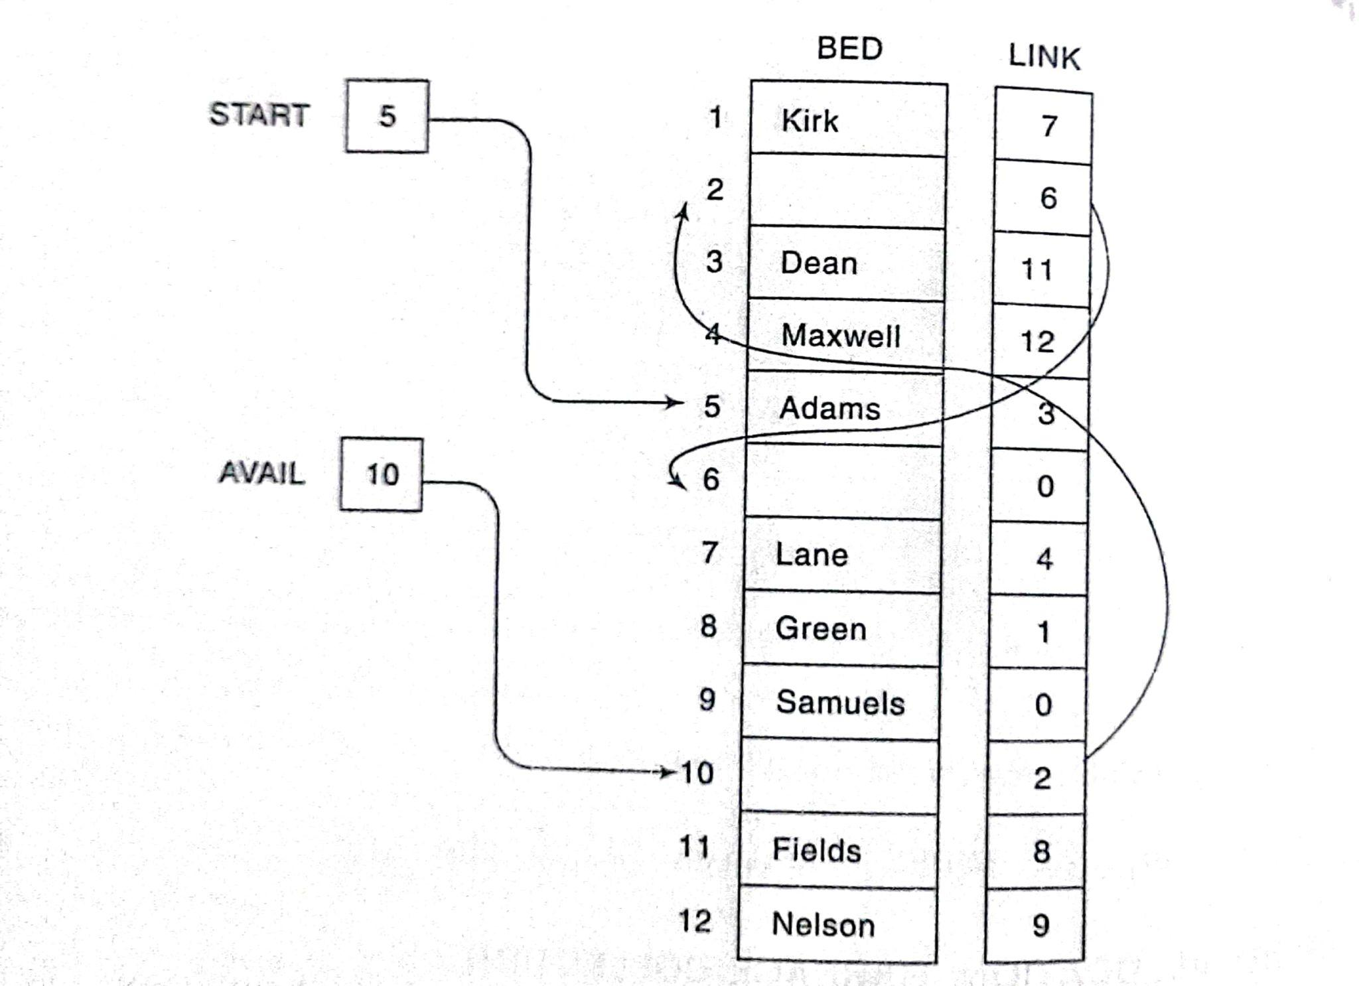

Slide 101
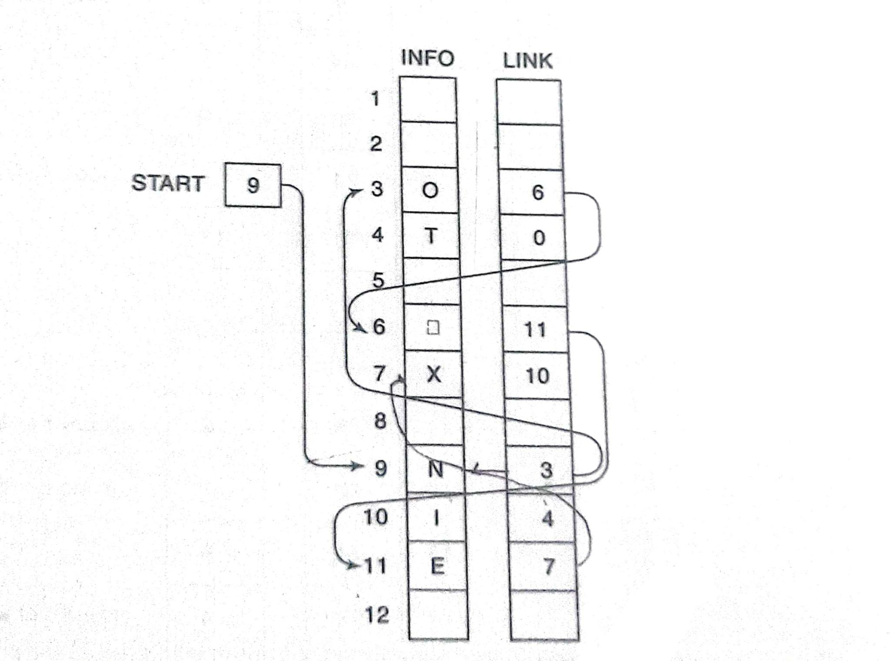
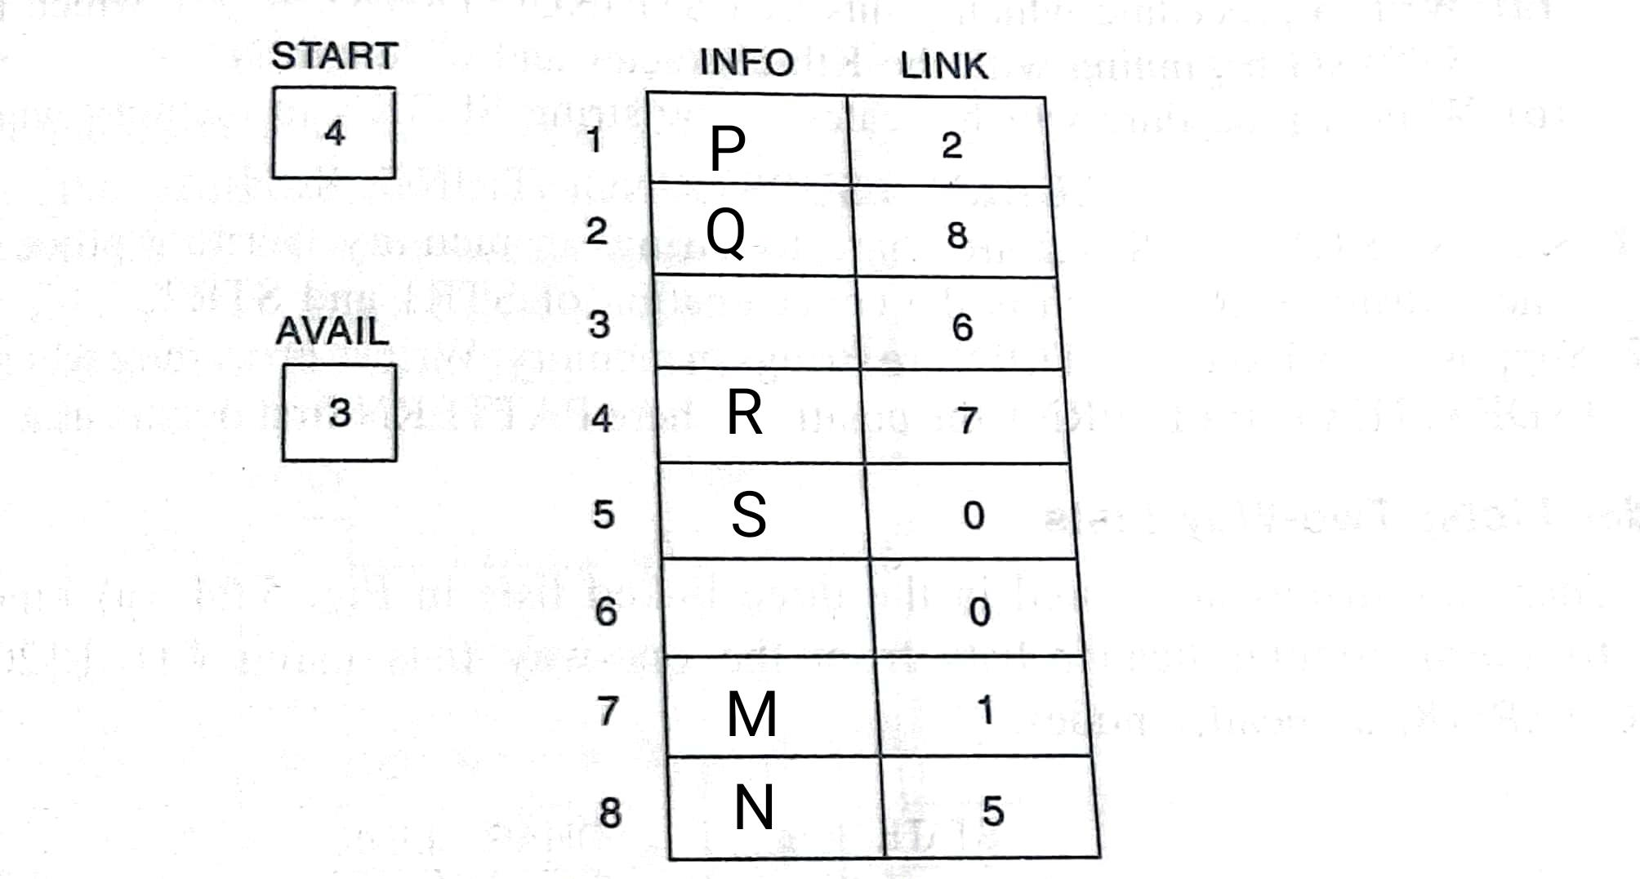

Slide 102
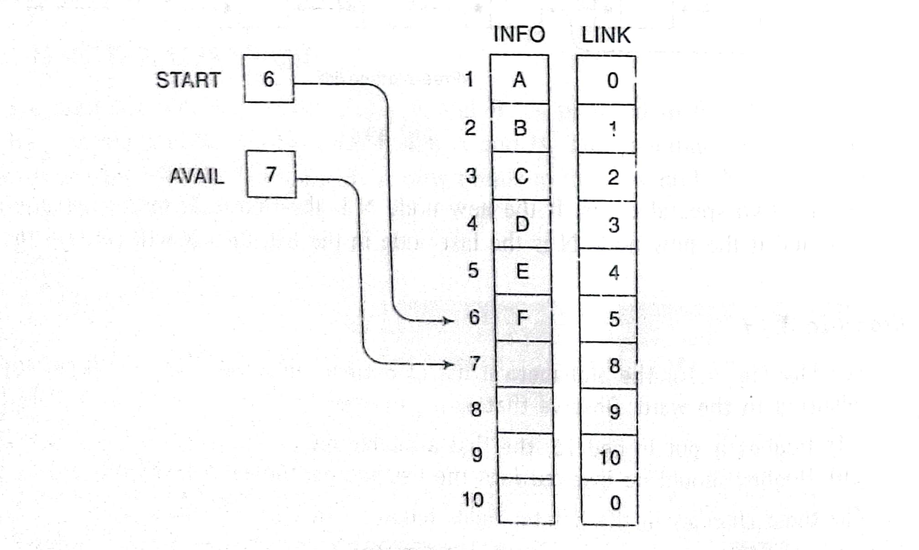

Slide 103
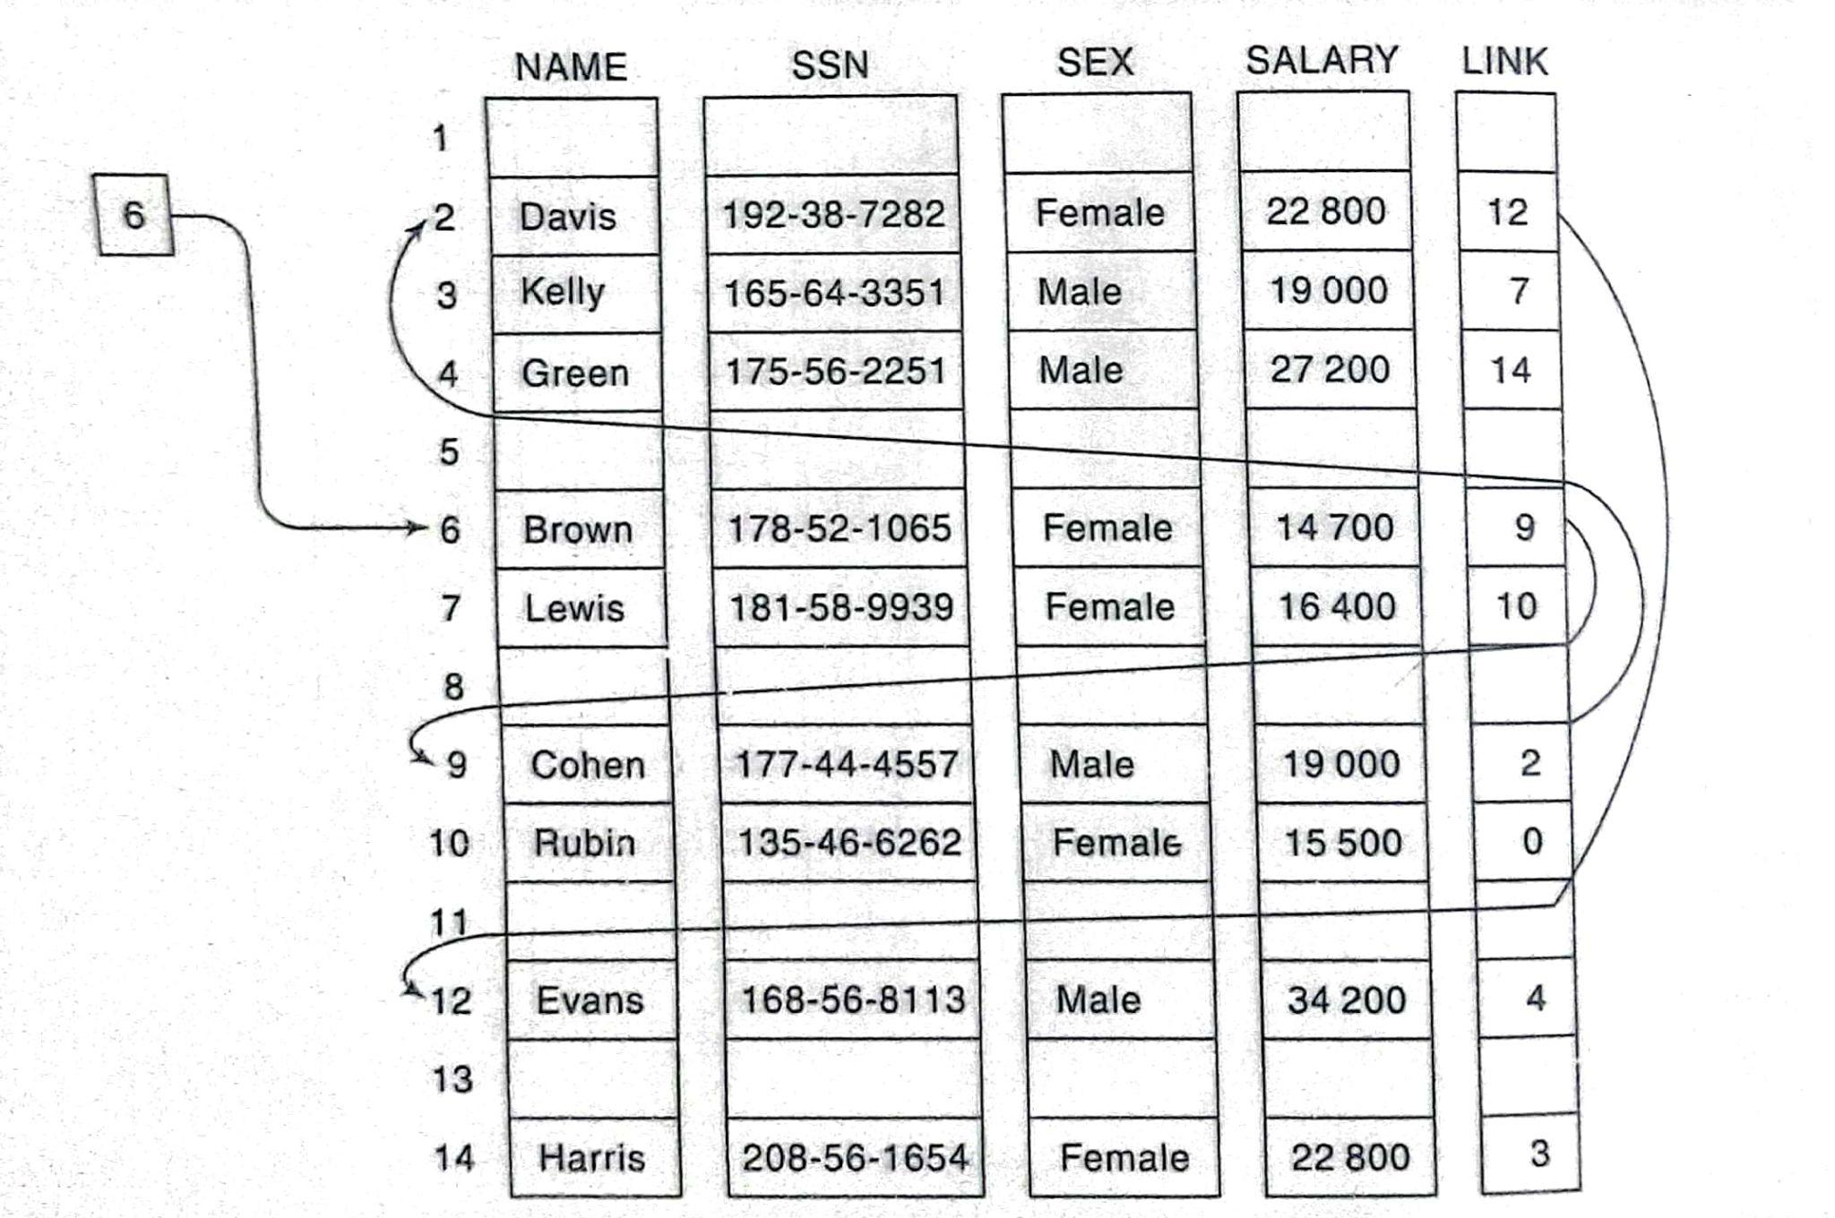

Slide 104
